Slide 1
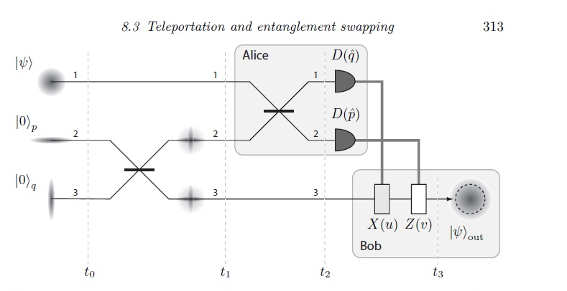
M(x)
M(p)
|x₂ + p₂>
|x₃ + p₃>
X(s)
Z(t)

